Slide 1
Beazley – Release 1.0 and Release 1.1
Mar 2026

Slide 2
Beazley Team Structure
Ananda Arasu Ponnaiah (Account Executive)
Offshore Team
Onshore Team
Ramesh ( Tech Lead )
Radhakrishnan
(Delivery Lead)
Sarah (Delivery Lead)
Manju
(PC Lead)
Gourab
(Integ Lead)
Ravi Tiwari
(BC Lead)
Sridhar
(QA Manager)
Vamshi (PC)
Ninad (QA)
3. Balaji(BC)
Sahersh(Intg)
Sherezad (PC- BA)
Rupesh(BC – BA)
Peter
1. Nikitha
2. Sujata
3. Vinith
4. Tarinee
5. Sanjeev
6. Mugunthan
7. Harini S
8. Loakash K
Basudev(UK)
10. Mallika (UK)
11. Abhipsa (UK)
1. Ravi P
2. Yaswanth
3. Kalyan
4. Vaibhav
1. Sandhya
Lokireddy
Kesari( UK)
4. Anantha(BA)
1. Komala (PC )
2. Anchal (BC)
3. Divya S (Integ)
4. Karuna (E2E/UAT)
5. Ravindher (Automation)

Slide 3
Beazley QA Team Structure
Off/Onshore Team
Sridhar
(QA Manager)
Komala
(PC)
Anchal
(BC)
Divya
(Intg)
Karuna
(E2E/UAT)
Ravnidher
(Automation)
1. Nikitha
2. Sujata
3. Vinith
4. Tarinee
5. Sanjeev
6. Mugunthan
7. Harini S
8. Loakash K
Basudev(UK)
10. Mallika (UK)
11. Abhipsa (UK)
1. Ravi P
2. Yaswanth
3. Kalyan
4. Vaibhav
1. Sandhya
Lokireddy
Kesari( UK)
1. Komala (PC )
2. Anchal (BC)
3. Divya S (Integ)
4. Karuna (E2E/UAT)
5. Ravindher (Automation)
1. Komala (PC )
2. Anchal (BC)
3. Divya S (Integ)
4. Karuna (E2E/UAT)
5. Ravindher (Automation)

Slide 4
GPAS – Guidewire code and environment management
The plan from Deve team will be as follows.
  GPASDEV & GPASSIT1 - will continue to deploy develop branch-> fixes for Pilot and Business Go Live scope until Release-1.1 cut is taken (Post 26th March).
  GPASDEV2, GPASSIT2, GPASTEST - Only Release-1.0 Branch (Any changes done to this branch will be auto cascaded back to develop branch. So future release will hold this fix already via develop branch)
  We should create a new Release-1.1 branch post Release-1.0 Go Live for Pilot and continue to use this branch for Release-1.1 (Pilot) via GPASDEV2, GPASSIT2, GPASTEST route. -> Any check in done to this Release-1.1 branch will auto cascade back to develop to keep the future release consistent with all the current development in this Release.
  Business Go Live changes will continue in develop branch and use GPASDEV & GPASSIT1 -> Post Release-1.1 cut taken
Post Production deployment, the Release branch will be merged with Master. And not used any further.
If a Hotfix is required in between, The Branch should be taken from Master and Merge back to Master and also to the next planned Release branch (which will cascade back to develop) - Use the GPASDEV4 (to be created) and GPASSIT4 for this purpose. We need to prep GPASSIT4 and complete smoke testing so we can keep this env ready.

Slide 5
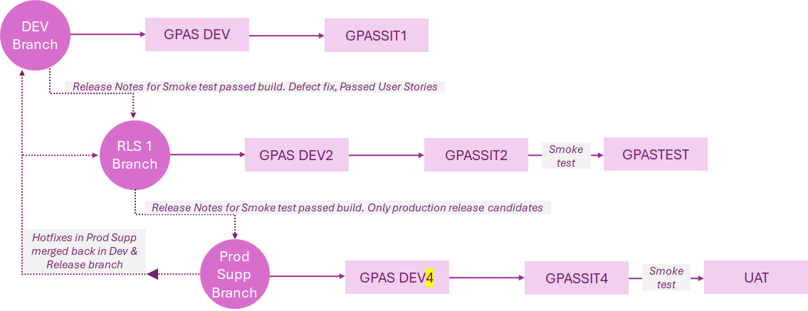
GPAS – Guidewire code and environment management
Another branch incl. Dev & SIT env for Small, Med changes to be deployed to Prod between major releases
Integrations | GPASSIT1 | GPASTEST | GPASIT4 | GPASSIT2 | UAT
Documents | Precisely | Precisely | Precisely | Precisely | Precisely
InSight | usdvws018:9001 | usdvws020:9001 | usdvws018:9001 | usdvws018:9001 | usdvws020:9001
CRM | Dev | Sys | Dev | Dev | Sys
MDM | Dev | Pre-Prod | Dev | Dev | Pre-Prod
UW Controls | DEV | SYS | DEV | DEV | SYS
CDA |  |  | N/A | N/A | N/A
BI | N/A | SYS | N/A | N/A | N/A
CededRI | N/A | SYS | N/A | N/A | N/A
Exp Mgt | N/A | SYS | N/A | N/A | N/A
Agresso | N/A | UAT | N/A | N/A | N/A
Integration setup to be completed for
GPASSIT4
GPASSIT2
UAT

Slide 6
GPAS – Guidewire code and environment management
DEV Branch
Sprint – Time travel Environment Will primarily used for Sprint Testing (Can be shared for any Release Testing)
GPAS DEV
GPASSIT1
GPASSIT3
Release Notes for Smoke test passed build. Defect fix, Passed User Stories
RLS 1 Branch
GPAS DEV2
GPASSIT2
Smoke test
GPASTEST
Release Notes for Smoke test passed build. Only production release candidates
Hotfixes in Prod Supp merged back in Dev & Release branch
Prod Supp
Branch
GPAS DEV4
GPASSIT4
Smoke test
UAT
CR/Medium/Low Priority Issues/ Continuous Release/BAU
Monthly Release
GPAS DEV4
GPASSIT5
Smoke test
UAT

Slide 7
GPAS – Guidewire Branching Strategy - Environments
Master (Production)
GPASSIT4
After deployed to Production
Cascade back to Next planned Release
Develop (Default)
GPASSIT1
Continuous Development of multiple Release/ features
Cascade Merge
Cascade Merge
Release Branch Cutover
Cascade Merge
Production Release complete
Release-N
GPASSIT2 -> GPASTEST
Cascade Merge
User branch PR Merge (fixes/features)
User branch PR Merge (fixes/features)
User branch PR Merge (fixes/features)
Current Planned Release
Production Release complete
Release Branch Cutover
Cascade Merge
Cascade Merge
Cascade Merge
Release-N+1
GPASSIT1 / GPASSIT5
User branch PR Merge (fixes/features)
User branch PR Merge (fixes/features)
User branch PR Merge (fixes/features)
Next Planned Release
Production Release complete
Hotfix Cutover
Hotfix
GPASSIT4
Adhoc Fixes (Urgent Issues)

